Slide 1
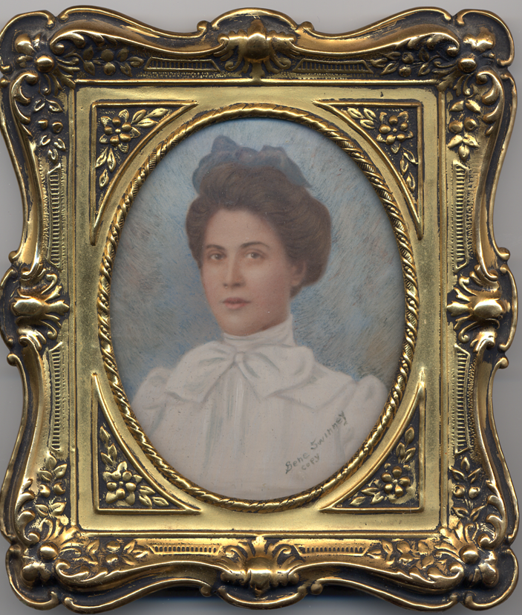
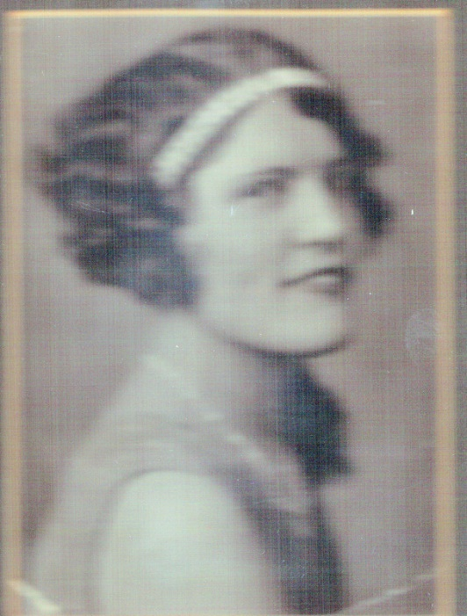
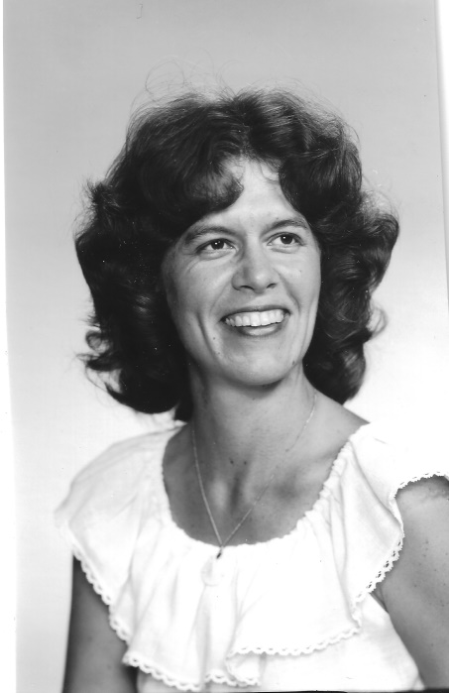
‘To the Rock that is Higher than I’: My Primitive Baptist Heritage and UU” Nancy Owen Nelson 2/23/25

Slide 2
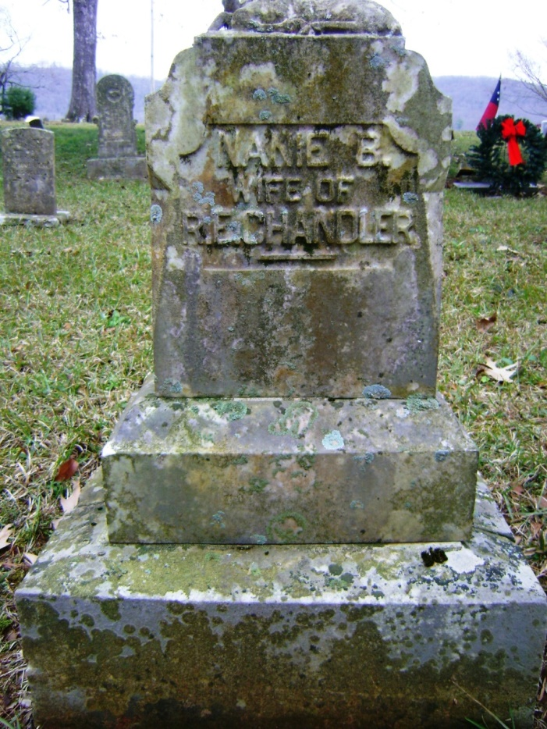
Original Gravestone for “Nanie B Wife of R. E. Chandler”

Slide 3
By way of Primitive Baptist Universalists

Slide 4
From “Sinners in the Hands of an Angry God” Jonathan Edwards (1703-1758) Enfield, Connecticut July 8, 1741
There is no want of power in God to cast wicked men into hell at any moment. Men's hands cannot be strong when God rises up. The strongest have no power to resist him, nor can any deliver out of his hands. -- He is not only able to cast wicked men into hell, but he can most easily do it. Sometimes an earthly prince meets with a great deal of difficulty to subdue a rebel, who has found means to fortify himself, and has made himself strong by the numbers of his followers. But it is not so with God. There is no fortress that is any defence [sic] from the power of God.
https://www.ccel.org/ccel/edwards/sermons.sinners.html

Slide 5
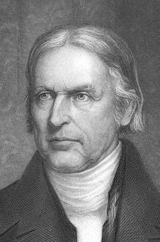
Hosea Ballou, Universalist Minister 1771 - 1852
Hosea Ballou (1771-1852)

Slide 6
From Dorgan’s Book, In the Hands of a Happy God
Dorgan revealed a key “Universalist antecedent” to the PBU belief, Hosea Ballou (1771-1852), “an early nineteenth-century Baptist turned Universalist,” who found images of a wrathful god “mean-spirited, vindictive, and—worst of all—‘arbitrary,’ ready to allow interminable suffering to be visited upon those he created, and prepared to justify such an eternity of horror on the grounds of his absolute loathing for these works of his own hands” (Dorgan 106). Ballou wrote that “a mistaken idea has been entertained of sin . . . . that it is the greatest folly in the world for people to forego salvation in a future state for the comforts and pleasures of sin in this. . . . . Sin . . . was never able to furnish one drop of cordial for the soul; . . . Sin is a false mirror, by which the sinner is deceived in everything on which his mind contemplates. . . . In a word, sin is a torment-giving nature to every faculty of the soul, and it is the moral death of the mind” (qtd in Dorgan 112). Of interest to this audience is Dorgan’s statement that “Universalism held closer to its traditional Christian base. . . . Unitarianism, on the other hand, placed considerable emphasis upon enlightened humanity’s ability to reason a way into social and spiritual goodness”(108).

Slide 7
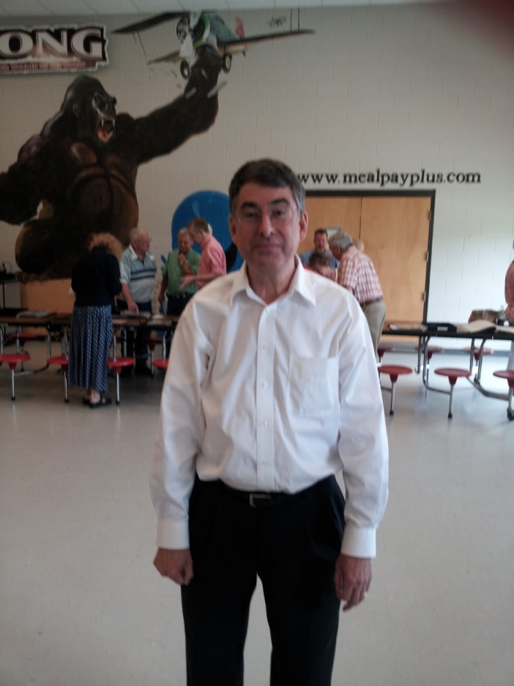
, Sherman Isbell, Retired Presbyterian minister and Primitive Baptist Scholar (with King Kong) and Scholar

Slide 8
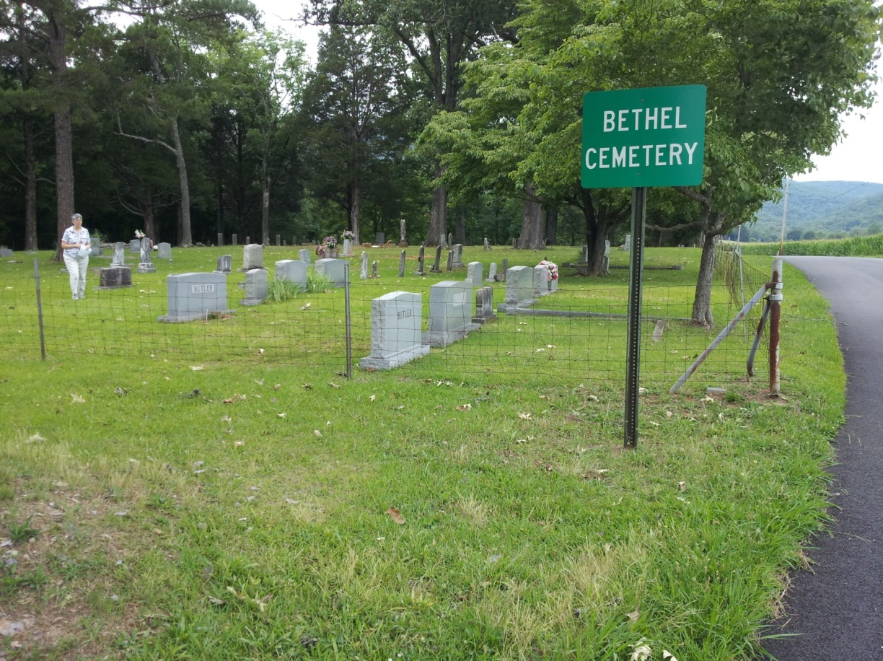
Bethel Primitive Baptist Cemetery, New Hope, Alabama

Slide 9
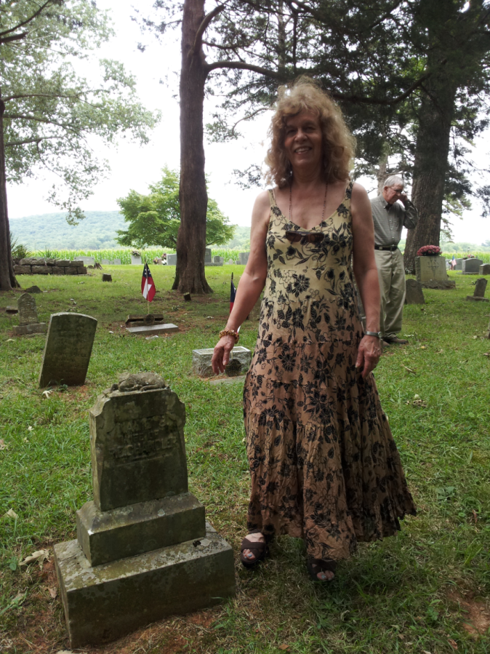
Meeting my grandmother

Slide 10
Original Gravestone for “Nanie B Wife of R. E. Chandler”

Slide 11
Brochure from the Bethel Church

Slide 12
Pew: Original Bethel Church

Slide 13
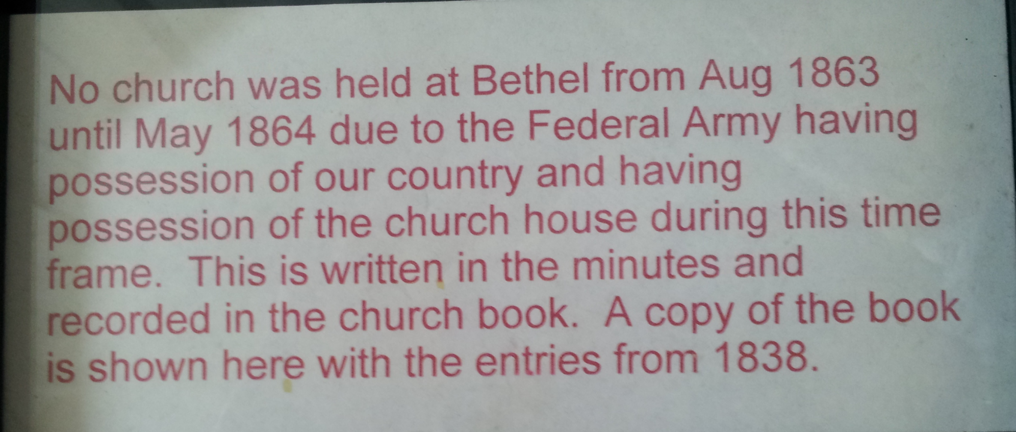
Bethel Church in the Civil War

Slide 14
Bethel PB Church Sanctuary

Slide 15
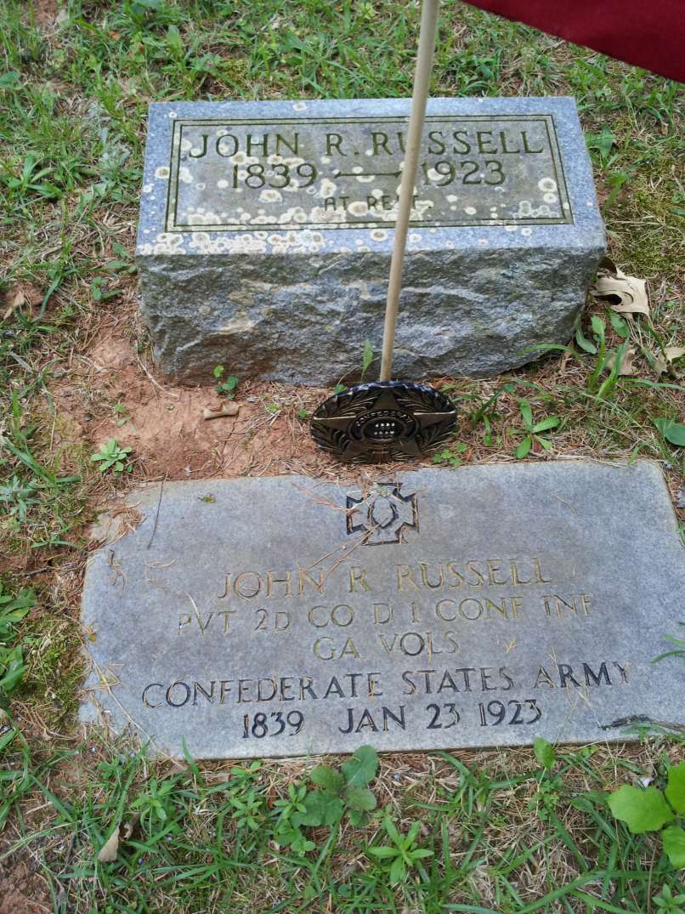
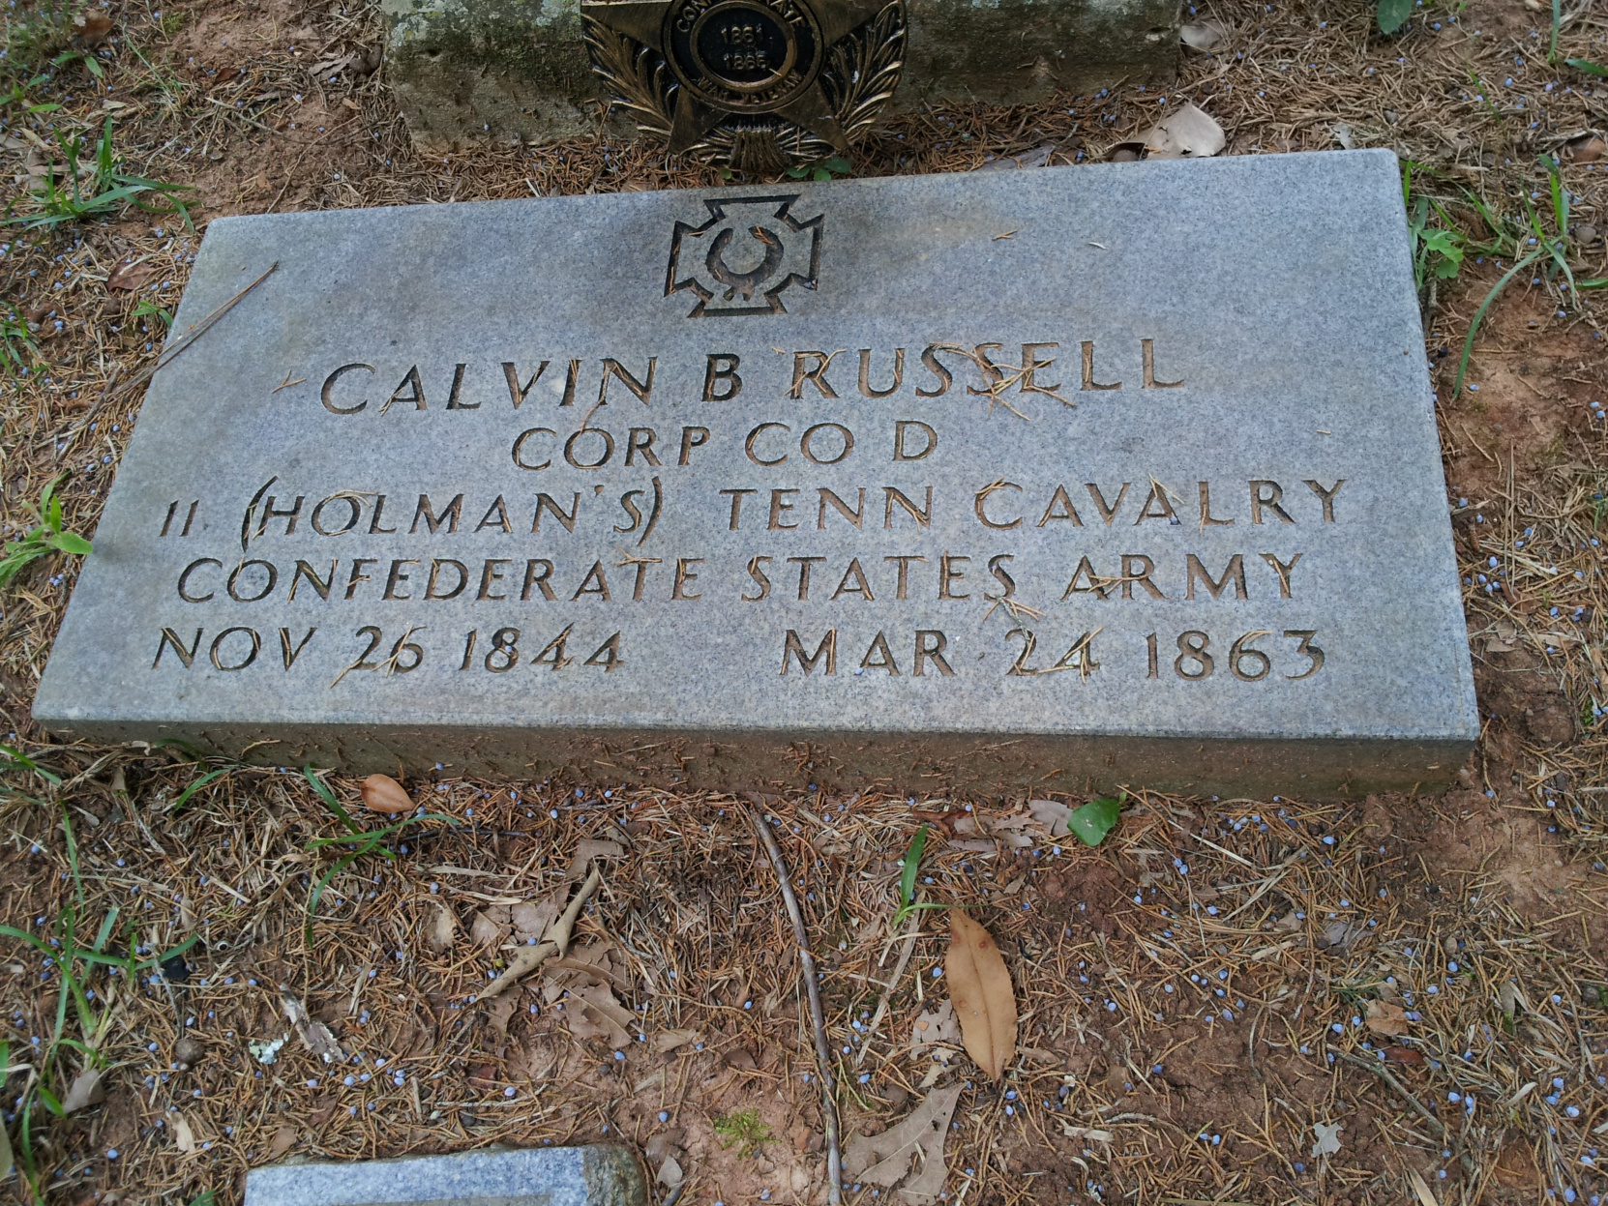
John R. Russell, Great Grandfather
Calvin B. Russell, Great Uncle

Slide 16
Brochure from the Bethel Church

Slide 17
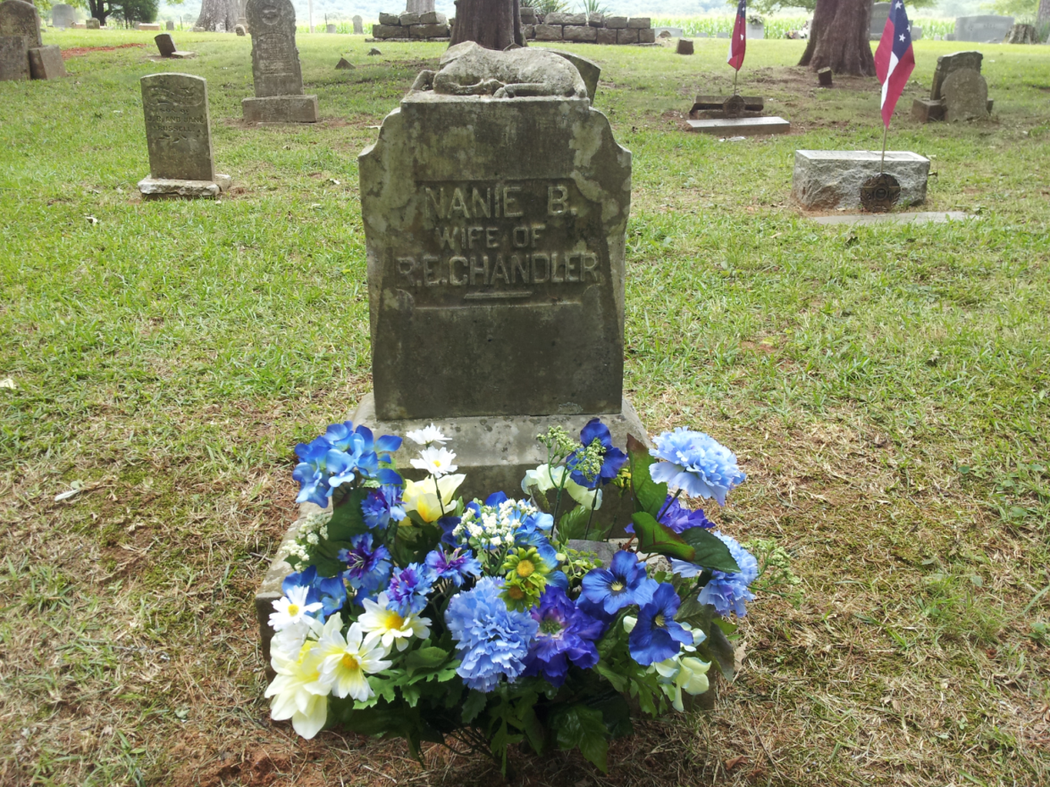
Honoring Nannie B Russell Chandler

